Slide 1

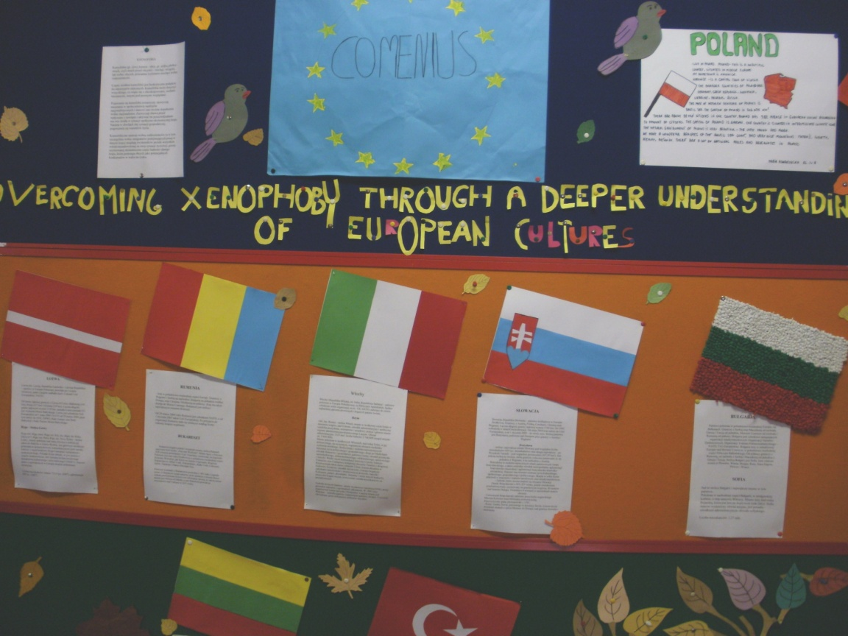
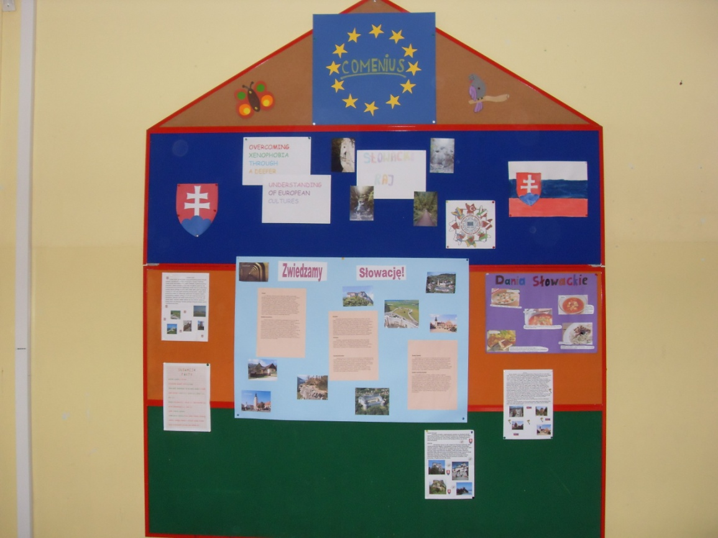
COMENIUS OPEN DAY
IN POLAND

Slide 2
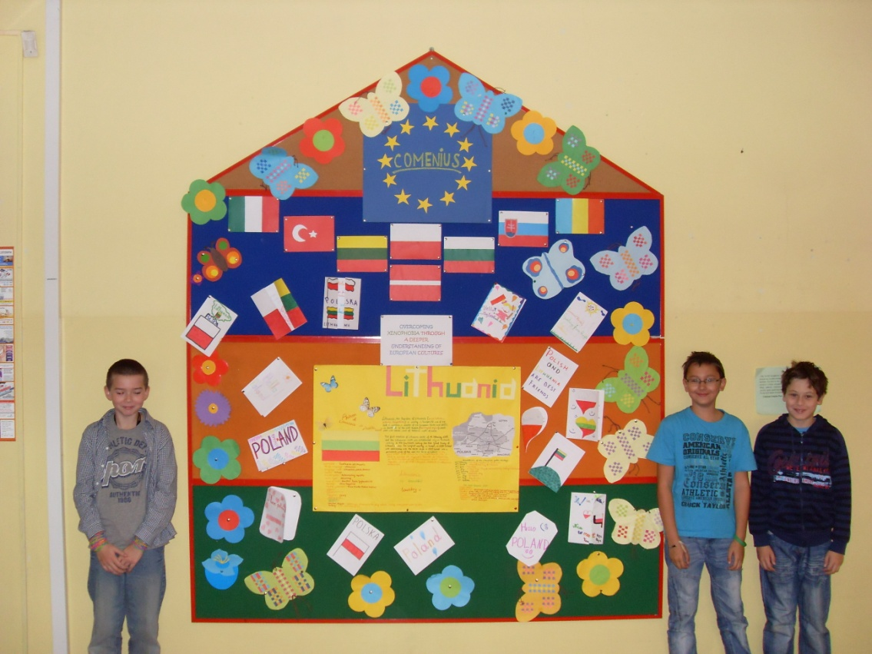
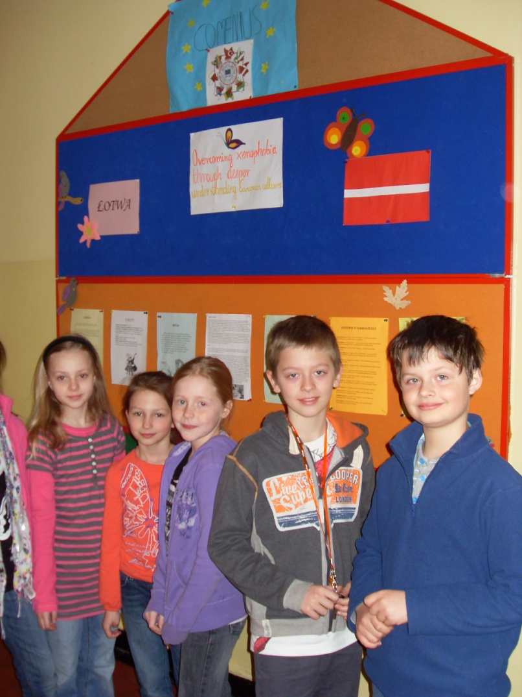
Comenius Open Day in Primary School
in Katowice was held on 25th May 2011.

Slide 3
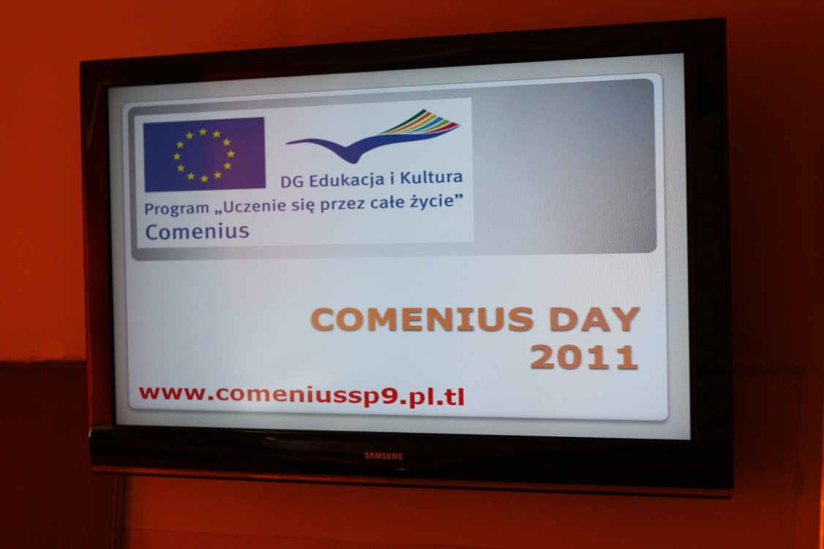
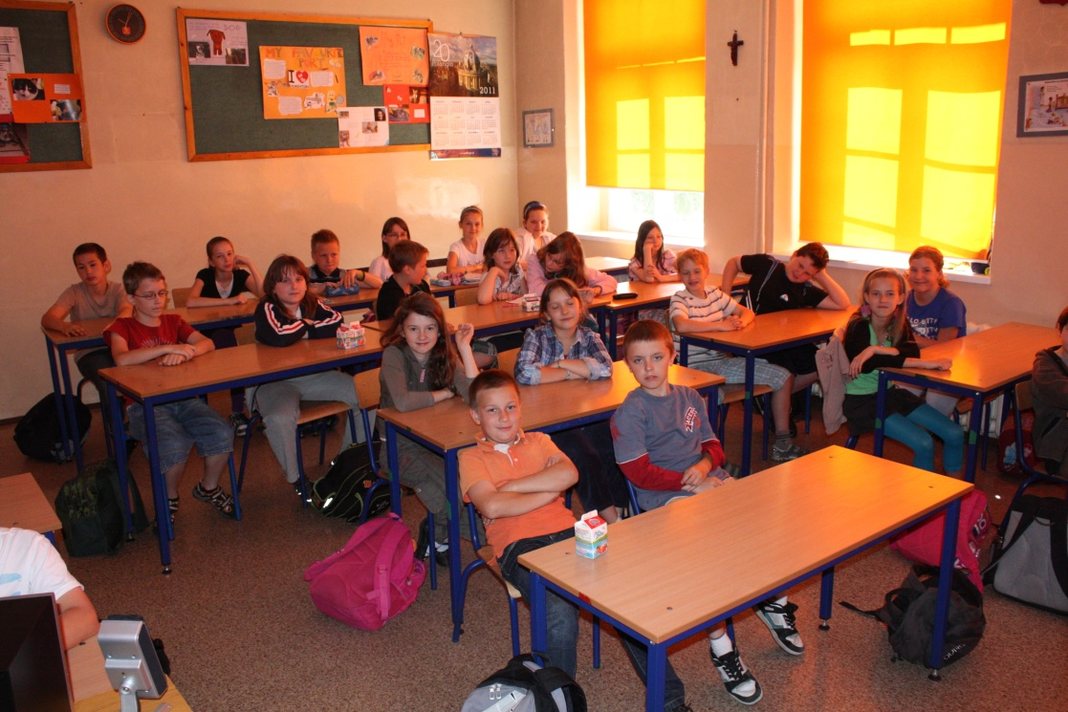
The students and teachers had the opportunity to watch all multimedia presentations made by partner schools.

Slide 4
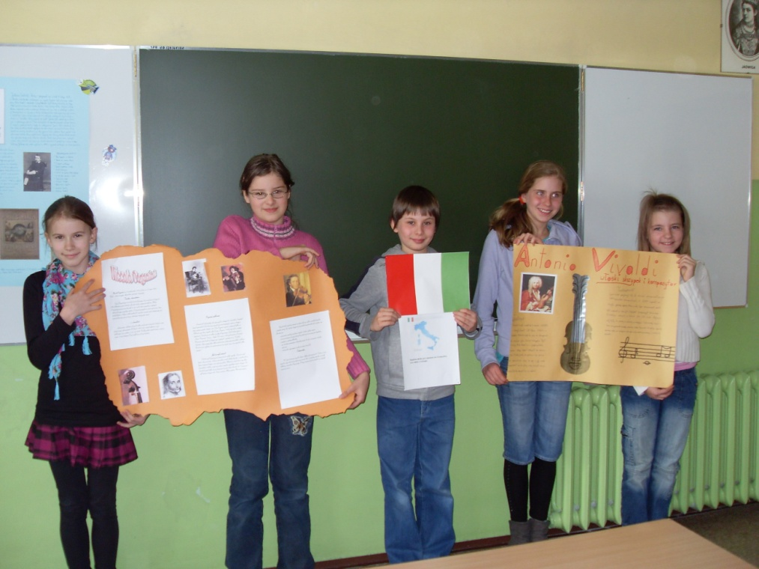
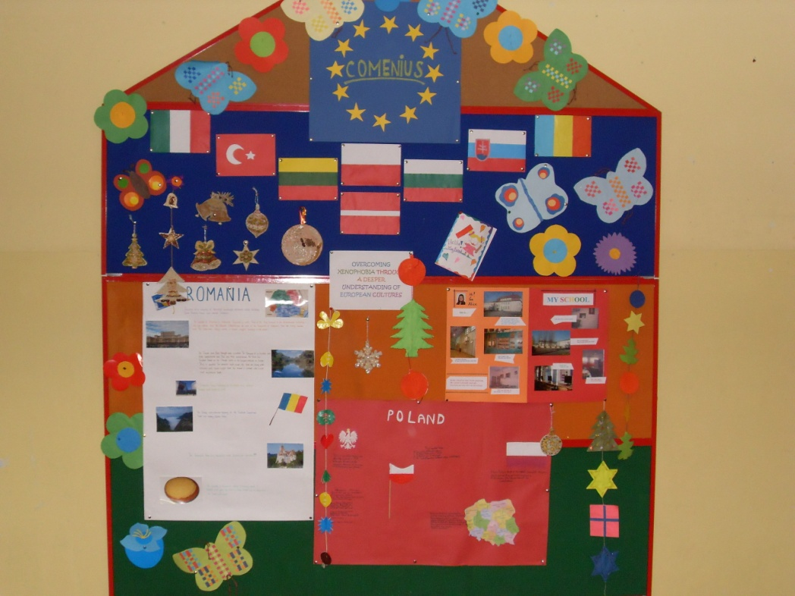
The students prepared Comenius exhibitions presenting partner countries’ culture and traditions.

